Slide 1
Integrated HIV/AIDS Project Haut Katanga and Lualaba
Index testing innovations in complex settings: Lessons from the Democratic Republic of the Congo
Davina Canagasabey
Program Officer—HIV
PATH
Notes:
Good evening, everyone. My colleague, Dr. Didier Kamerhe, is unfortunately unable to be here today but I am delighted to present on Dr. Kamerhe’s behalf the exciting work that we are currently doing in the Democratic Republic of the Congo, using index testing to improve case finding among hard-to-reach HIV-positive people unaware of their status and link them to treatment, in support of epidemic control.

Slide 2
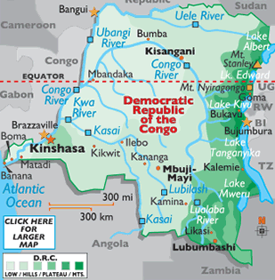
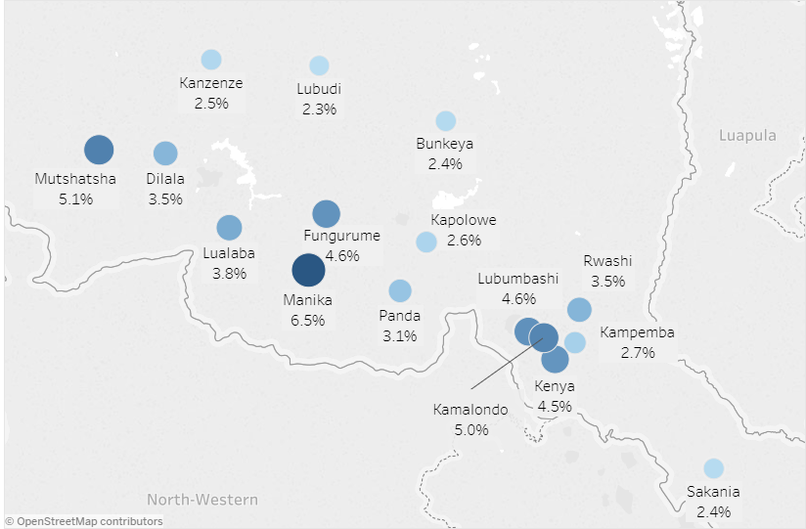
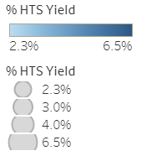
HIV epidemic in Haut Katanga and Lualaba
The PEPFAR-funded Integrated HIV/AIDS Project in Haut Katanga and Lualaba (IHAP-HK/L) provides comprehensive HIV services to achieve epidemic control in the Democratic Republic of the Congo (DRC).
Results: Seropositivity by health zone (January—March 2018)
IHAP-HK/L operates in 16 health zones across two provinces.
Likasi
Lubumbashi
Notes:
PATH has been implementing programming to combat the HIV epidemic in the DRC since 2009, and currently leads the PEPFAR/USAID-funded Integrated HIV/AIDS Project in Haut Katanga and Lualaba (IHAP), where we provide technical assistance to over 150 health facilities and local nongovernmental organizations to deliver high-quality HIV prevention, testing, and treatment services in 16 health zones in the southeastern portion of the country.
The HIV epidemic in the DRC is concentrated in key and priority populations, and in Haut Katanga and Lualaba, this means miners, truck drivers, and sex workers. The map on your right shows seropositivity by health zone across the 16 zones that IHAP currently operates in, with the larger and darker blue circles denoting higher seropositivity. As you can observe in the figure, there is a band of darker blue circles in Mutshatsha, Fungurume, and Manika health zones in Lualaba which have significant mining activities, and then traveling along the copper transportation corridor through Lubumbashi and into southern Africa.

Slide 3
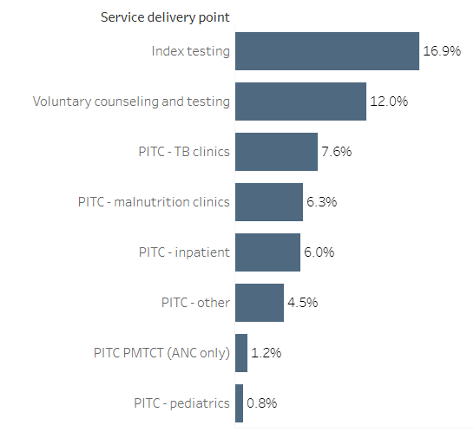
Complexities of finding positives
From April through June 2017
50,098 individuals tested for HIV across all entry points.
2,061 identified HIV-positive (4.1%).
4.9% yield in Lualaba versus 3.8% in Haut Katanga.
90% linkage to treatment.
Yield by entry point, July-September 2017
IHAP-HK/L introduced index case testing in June 2017 to improve facility-level case finding and increase testing efficiency.
Abbreviations: ANC—antenatal care; PITC—provider initiated counseling and testing; TB--tuberculosis
Notes:
During the first three months of project implementation, more than 2,000 of the 50,000 individuals tested for HIV were identified HIV-positive, which reflects a seropositivity of 4.1%. 90% of those identified HIV-positive were enrolled in antiretroviral therapy. However, programmatic data and national estimates indicate prevalence to be much higher in priority populations, so a challenge that we faced was scaling up testing strategies that could more efficiently target and test those most likely to be HIV-positive.
One strategy to increase targeted identification of HIV-positive individuals was index case testing, which we rolled out across all project facilities in June 2017. We reported data on index testing entry point starting in July, and as noted in the figure, index case testing became the highest yield entry point, with 16.9% yield for the July-September period.

Slide 4
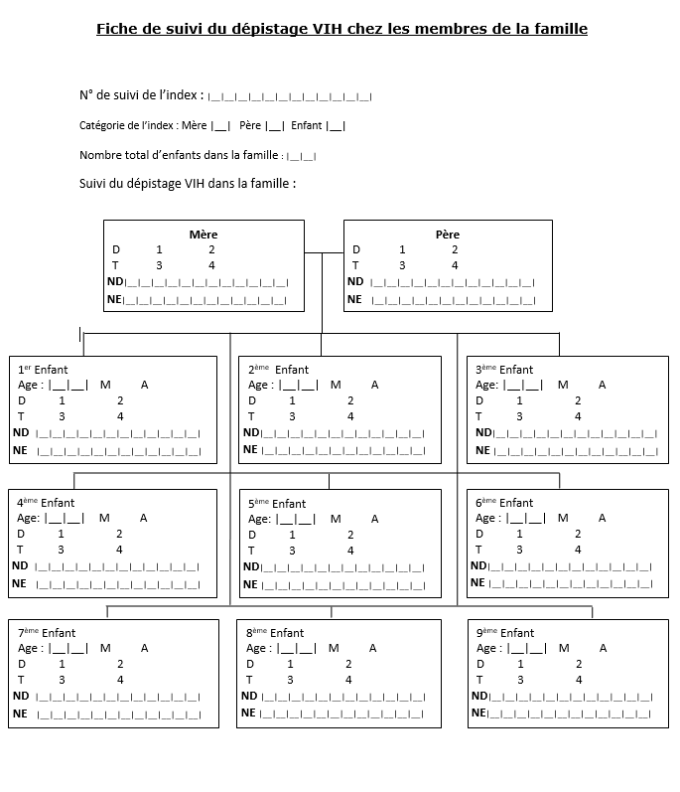
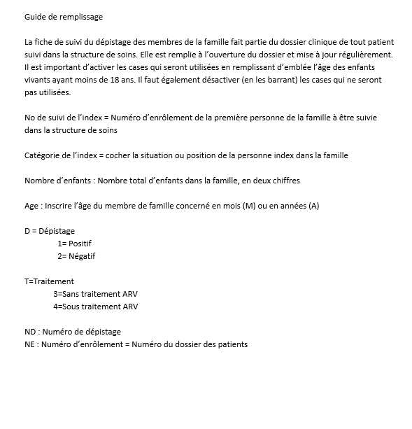
Strategies to improve index case testing yield
Enhance provider understanding of index case testing and optimal targeting.
Use family tree forms to track partners and children of PLHIV for testing.
Expand HIV testing services at community-level (e.g., PoDi+ sites, PLHIV support groups).
Notes:
Based on this initial success, beginning in October 2017, we took additional steps to intensify offering of index case testing, focusing on three main areas:
Coaching facility-based service providers to better understand the definition of index cases and groups targeted for index case testing i.e. sexual partners and biological children of PLHIV in the facility’s treatment cohort.
Distributing « family tree forms » and providing supportive supervision to facility-based providers to identify and follow up with sexual partners and biological children of PLHIV for testing using the form.
Improving accessibility of testing services for partners and children of PLHIV by integrating testing at community-based points of treatment distribution (PoDi+ sites) or home-based testing.

Slide 5
Index testing: Results from July 2017 through May 2018
Facility-based index case testing results, July 2017 – May 2018.
Yield: 27.8%
Yield: 27.4%
Yield: 24.1%
Yield: 16.9%
26.6% of the 2,419 individuals tested from July 2017 through May 2018 were HIV-positive.
All 645 people who tested HIV-positive were enrolled on treatment.
Notes:
This slide shows quarterly results from index case testing from July 2017 through May 2018. As the figure shows, after implementing these three strategies, IHAP-supported facilities were able to identify a greater number of people unaware of their HIV-positive status and link them to treatment. Facility-based index testing progressively increased each quarter, both in terms of absolute numbers of people tested and seropositivity.
Nearly 27% of the almost 2,500 partners and children tested were HIV-positive. As a result of index case testing, more people living with HIV were identified and put on treatment each quarter, increasing from 40 people in the July-September 2017 period to 270 in April and May 2018.

Slide 6
Index testing: Results from July 2017 through May 2018
Facility-based index case testing results by province, July 2017 – May 2018.
Yield:
July-Sept 2017: 16%
April-May 2018 25%
Yield:
July-Sept 2017: 37%
April-May 2018 33.6%
Higher yield observed in Lualaba (30.8%) than Haut Katanga (23.5%).
Notes:
This figure provides a breakdown of the same results from the previous slide but by province. As you’ll note, even though twice as many individuals were tested in Haut Katanga (1,793) than in Lualaba (863), the yield in Lualaba was much higher, almost 31% compared to 24% in Haut Katanga, reflecting the higher prevalence observed in Lualaba due to mining activities. This data further underscores the need to focus testing efforts in Lualaba in order to identify PLHIV currently unaware of their status.

Slide 7
Index testing: Results from June 2018
Index case testing results versus other testing entry points, June 2018
Index case testing results by population, June 2018
Yield: 4.5%
Yield: 14.9%
Yield: 36.1%
Yield: 9.2%
5,377 people tested from June 1-22; 427 tested HIV-positive (7.9%)
1,782 partners and children of 851 PLHIV were tested through index case entry point.
More biological children than sexual partners were tested, but higher percentage of HIV-positive people identified among sexual partners of PLHIV.
Notes:
To further optimize future outreach strategies we began collecting disaggregated data for sexual partners and biological children tested under the index case entry point at 72 facilities during a three week period in June. Of the more than 5,000 individuals tested across all modalities, 427 tested HIV-positive, an overall yield of 7.9%. However, as the figure on your left indicates, a greater percentage of HIV-positive individuals were identified through index case testing, almost 15%, compared to 4.5% at other testing entry points.
As the figure on your right shows, the majority of those tested under the index case entry point in June were children of HIV-positive individuals, with only 21% of those tested representing sexual partners, but the seropositivity among partners was significantly higher, at more than 36% in comparison to 9% among children. A question that this raises is whether we’re testing too many children and if should we, perhaps, consider using risk assessments to only test children who have a higher likelihood of being HIV-positive, in order to further increase our testing efficiency.

Slide 8
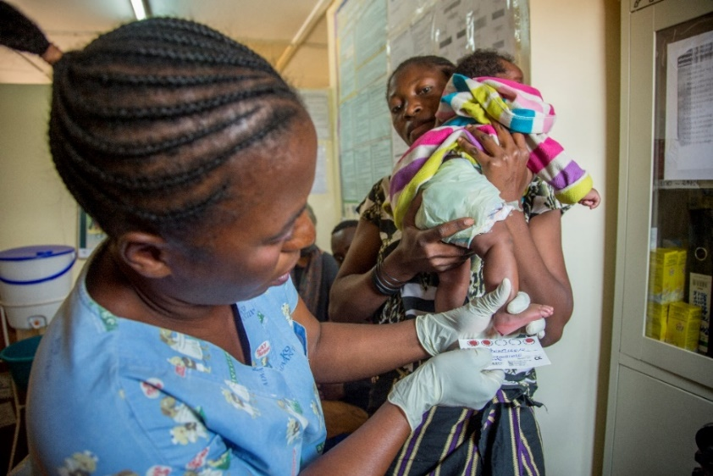
Promising solutions for reaching partners
Challenge: Difficult to reach sexual partners of HIV-positive individuals with testing services—379 partners of 851 PLHIV tested in June 2018.
Promising solutions:
Rolling out assisted partner notification to partners of HIV-positive individuals through peer educators.
Expanding provision of HIV testing services at PoDi+ sites and PLHIV support groups (more than 60% of those tested at support groups were partners of PLHIV).
Intensifying targeted home-based testing (5.3% seropositivity; 28% among partners).
136 partners and children tested at PoDi+ sites (5.1% seropositivity), and 87 tested at PLHIV support groups (13.8% seropositivity) from April through June 2018.
Credit: PATH
Credit: PATH
Credit: PATH
Nurse at Kenya General Reference Hospital in Lubumbashi, collects a dried blood spot sample from an exposed infant.
Notes:
As the previous slide highlighted, facilities are still having difficulty reaching partners of PLHIV through traditional (facility-based) testing services. Only 44% of partners of HIV-positive individuals were tested in June, yet the yield among partners was much higher. So, in order to get us to epidemic control in HK and L, we really need additional solutions to reach and test partners of HIV-positive individuals currently unaware of their status and link those who test positive to treatment.
We have identified three promising solutions to improve our reach among this group:
Mentoring facility-based providers to shift from passive partner notification (by sending a note through HIV-positive individuals to invite their partners to facility for HIV testing) to a more active outreach approach using peer educators to support HIV-positive people encourage their partners to get tested for HIV.
Expanding provision of HIV testing at PoDi+ sites and PLHIV support groups. As data in red font shows, we’re seeing early success identifying positives at support groups in particular.
Intensifying targeted home-based testing efforts, particularly for partners of HIV-positive individuals.

Slide 9
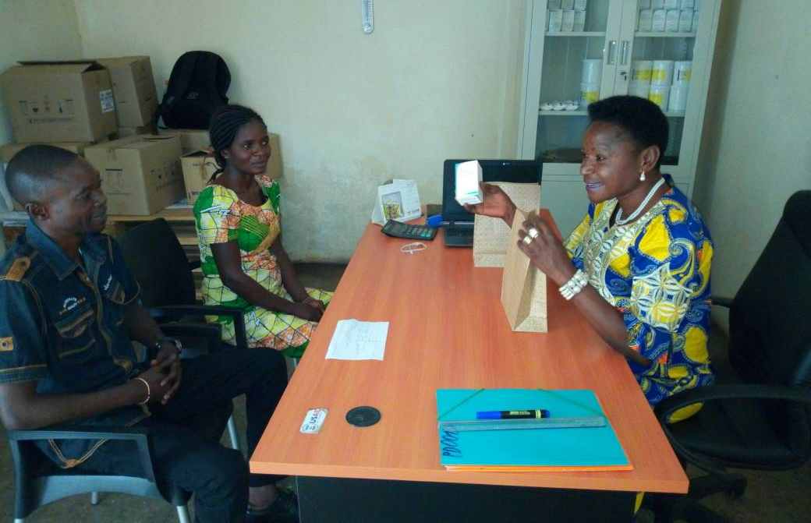
Acknowledgements
National Program for the Fight against HIV/AIDS (PNLS): Willy Mupanga; Baltas Kabeya
PEPFAR and USAID/Democratic Republic of Congo
World Health Organization
PATH: Pascal Milenge; Didier Kamerhe; Venant Cikobe; Ibou Thior; Lisa Mueller Scott; Johannes van Dam
Credit: PATH
Credit: PATH
Staff at the PoDi+ site in Kenya health zone providing antiretroviral medication and adherence counseling to a couple.
Notes:
And finally, I’d like to end with some acknowledgements. First a thank you to provincial coordinators of the PNLS who were instrumental in facilitating scale-up of index testing under the project; our donor, PEPFAR and USAID, and our colleagues at the Mission in Kinshasa; WHO for providing us with the opportunity to present our work here; and finally, the entire project team in DRC, particularly Drs. Milenge and Kamerhe who leads our clinical and community-based interventions. Thank you.

